Slide 1
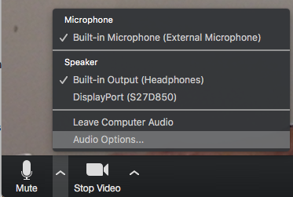
Zoom Participant Guide
Microphone & Camera Setup
Asking Questions
Turn mic on/off
Turn camera on/off
Open chat window
Notes:
Participants new to Zoom: please set up your microphone and camera for the webinar.

